Slide 1
Define POD Lifecycle?

Slide 2
Define POD Lifecycle?
When the request to create a pod within a Kubernetes cluster is accepted, the pod goes into pending state. This means that the pod is ready to be created but it has not been scheduled on any node. Then when the scheduler has decided a node for this pod and when the image is being pulled, the pod goes into creating state. If the image is pulled and deployed as a container within the pod successfully, the pod goes into running state. If by any chance, the pod fails or crashes by any reason then it goes into error state. The default behavior of a container inside a pod is to keep restarting it. When that happens for a failed pod, the status changes from error to crashloopbackoff. Then, there are other pod statuses as well like imagepullbackoff and some others.

Slide 3
What are Forward and Reverse proxies?

Slide 4
What are Forward and Reverse proxies?
Forward proxy: is a server that sits between client machines and internet. So, whenever a client machine tries to access any content on internet, each request from the clients is intercepted by a forward proxy server before the request reaches a web server.
Benefits: To hide client’s IP addresses from web server, to block access to certain sites using filtering rules.

Slide 5
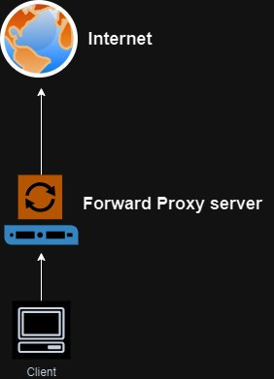

Slide 6
What are Forward and Reverse proxies? [contd.]
Reverse proxy: is a server that sits between internet and web servers. So, whenever a client machine tries to access any web server from internet, each request from the clients is intercepted by a reverse proxy server before the request reaches a web server.
Benefits: To protect a web site (example: DDoS attacks) by hiding the IP addresses of the web site from clients, load balancing, to cache static content, can perform SSL encryption

Slide 7
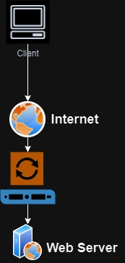
Reverse Proxy Server

Slide 8
What is a CVE?

Slide 9
What is a CVE?
CVE: stands for Common Vulnerabilities and Exposures. There is a central repository which contains the list of publicly exposed vulnerabilities standardized by MITRE (https://cve.mitre.org). This repository has vulnerabilities listed from different vendors (RedHat, Microsoft, CrowdStrike etc.) with the URL pointing to vendor article for a particular vulnerability. You also get a CVSS score for each vulnerability to quantify the impact.

Slide 10
What is WireShark?

Slide 11
What is WireShark?
is an open network sniffing software, which is designed to track network packets by using various filter options available. It is used to analyze network packets, troubleshoot network issues, to check malicious and hacking possibilities. Generally used to trace protocol related information.

Slide 12
What is Apache Tomcat?

Slide 13
What is Apache Tomcat?
is a widely used open-source web server and Java servlet container, created by Sun Microsystems as the reference implementation of Java servlet and Java Server Pages (JSP), and it was eventually donated to Apache Software foundation.
Advantages:
Serves as both Web Server and Servlet Container
Free and open-source,
lightweight
highly adaptable due to built-in customization feature
very stable
very good documentation
Disadvantages:
Problem with SSL setups, Memory leak, does not manage logs well, poor UI

Slide 14
What is Nginx?

Slide 15
What is Nginx?
is a webserver that accept HTTP/HTTPS requests and displays the web content by delivering web pages to users. Also used as Load Balancer, reverse proxy, mail proxy, and HTTP cache.

Slide 16
What are quality gates? Or How to confirm that a built artifact is good?

Slide 17
What are quality gates?
It enforces a quality policy in your organization to define a set of conditions against which projects are measured. Example: When you are using Sonarqube scanner in a Jenkins pipeline to perform static code analysis, you use these quality gates to set some measurable criteria to ensure that your built artifact passes that, like:
Code coverage should be >= 80%
Security rating = A
Reliability rating = A
Duplicated lines of code <= 3
https://docs.sonarsource.com/sonarqube/latest/user-guide/quality-gates/

Slide 18
What are different type of attacks, like DDoS?

Slide 19
What are different type of attacks, like DDoS?
Malware attack
DDoS
Phishing attacks
Ransomware
SQL Injection
Smishing attack
Packet sniffer
Botnet

Slide 20
What is CIDR?

Slide 21
What is CIDR?
CIDR stands for Classless Interdomain Routing. It is a networking concept designed to replace the outdated way of classful addressing system.
It helps in low wastage of IP addresses as the IP addresses are assigned in sequence.
Number of addresses in a CIDR block will always be the power of 2.

